Slide 1
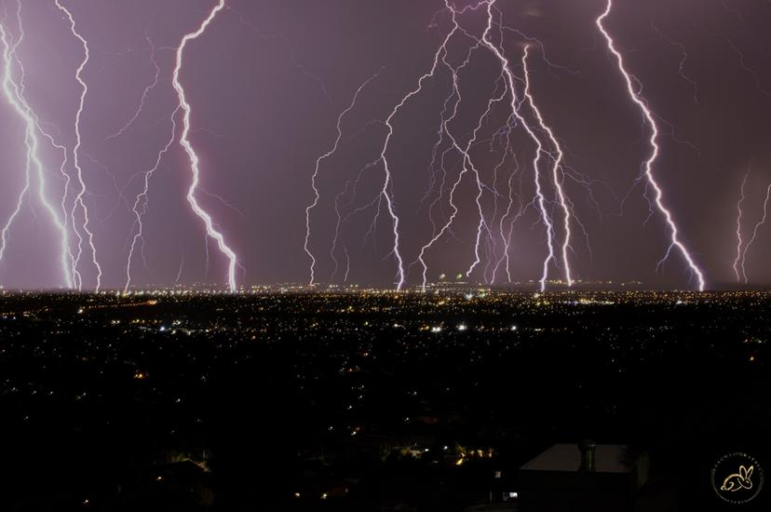
Lightning Jump Detection & Severe Weather Forecast
Presented by: Chi Zhang, Georgia Cleaver & Jonathan Wu

Slide 2
What is a lightning jump?
A lightning jump occurs when there is a rapid increase in the total flash rate.
Magnitude of total flash rate not as relevant as magnitude of rate of change.
- Gatlin & Goodman (2010)
- Schultz et al. (2015)
Lightning jumps are electrical response to the updraft behaviour during storm evolution.
- Gatlin & Goodman (2010)

Slide 3
Benefits of a Lightning Jump Algorithm
More lead time in providing severe weather warnings.
Potential to indicate the dissipation of a storm (Chronis et al. 2015).
Allows us to identify and track most active regions of storm cells.
Complementary to radar data for identifying severe weather.

Slide 4
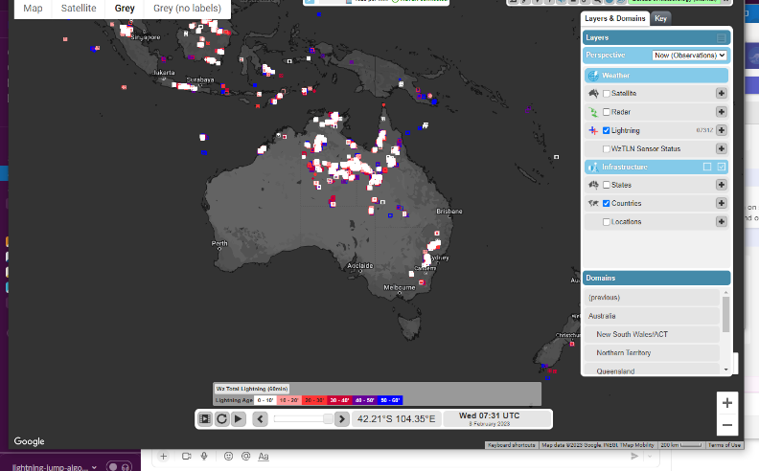
Project: Main Steps
Conduct a literature review.
Create a lightning jump detection algorithm using lightning data from WeatherZone Total Lightning Network.
Use hail data from the Operational Radar Network to validate the algorithm.
Conduct analysis on the results.

Slide 5
Logic Flowchart
Ground Based
Lightning Data
Lightning Collection
of Case Study
Lightning Cluster in
Specific Time Range
Preliminary Analysis
Obtain Lightning Jump
Period in each Cluster
Detect Lightning Jump
with 2-Sigma Algorithm
Track Lightning Cluster
Movement Track
Use LJ Centroid to
Detect the Nearby Radar
Record the SHI Information
from the Detected Radar
Parallel Processing
(More Case-Study)

Slide 6
Data
· Raw-Data — Yearly Recorded Data of Lightning Strike in Australia
· Preprocessing — Split into 365 CSV files (366 if Leap Year)
· Data Information — Time, Location, Lightning Type, Lightning AMP
· Case-Study — A Specific Location with Severe Weather during the Selected Date
· e.g. — Brisbane 2014-11-27 Lightning Data is Selected for Computing its Lightning Cluster

Slide 7
Logic Flowchart
Ground Based
Lightning Data
Lightning Collection
of Case Study
Lightning Cluster in
Specific Time Range
Obtain Lightning Jump
Period in each Cluster
Detect Lightning Jump
with 2-Sigma Algorithm
Track Lightning Cluster
Movement Track
Preprocessing
Use LJ Centroid to
Detect the Nearby Radar
Record the SHI Information
from the Detected Radar
Parallel Processing
(More Case-Study)

Slide 8
Lightning Cluster
Precondition Brought by the Data Characteristic
1. Number of CG Lightning vs. Number of IC Lightning < 10%
2. CG Lightning is Randomly Scattered in the Plot
=> Operate Clustering by Considering IC, CG Lightning Together

Slide 9
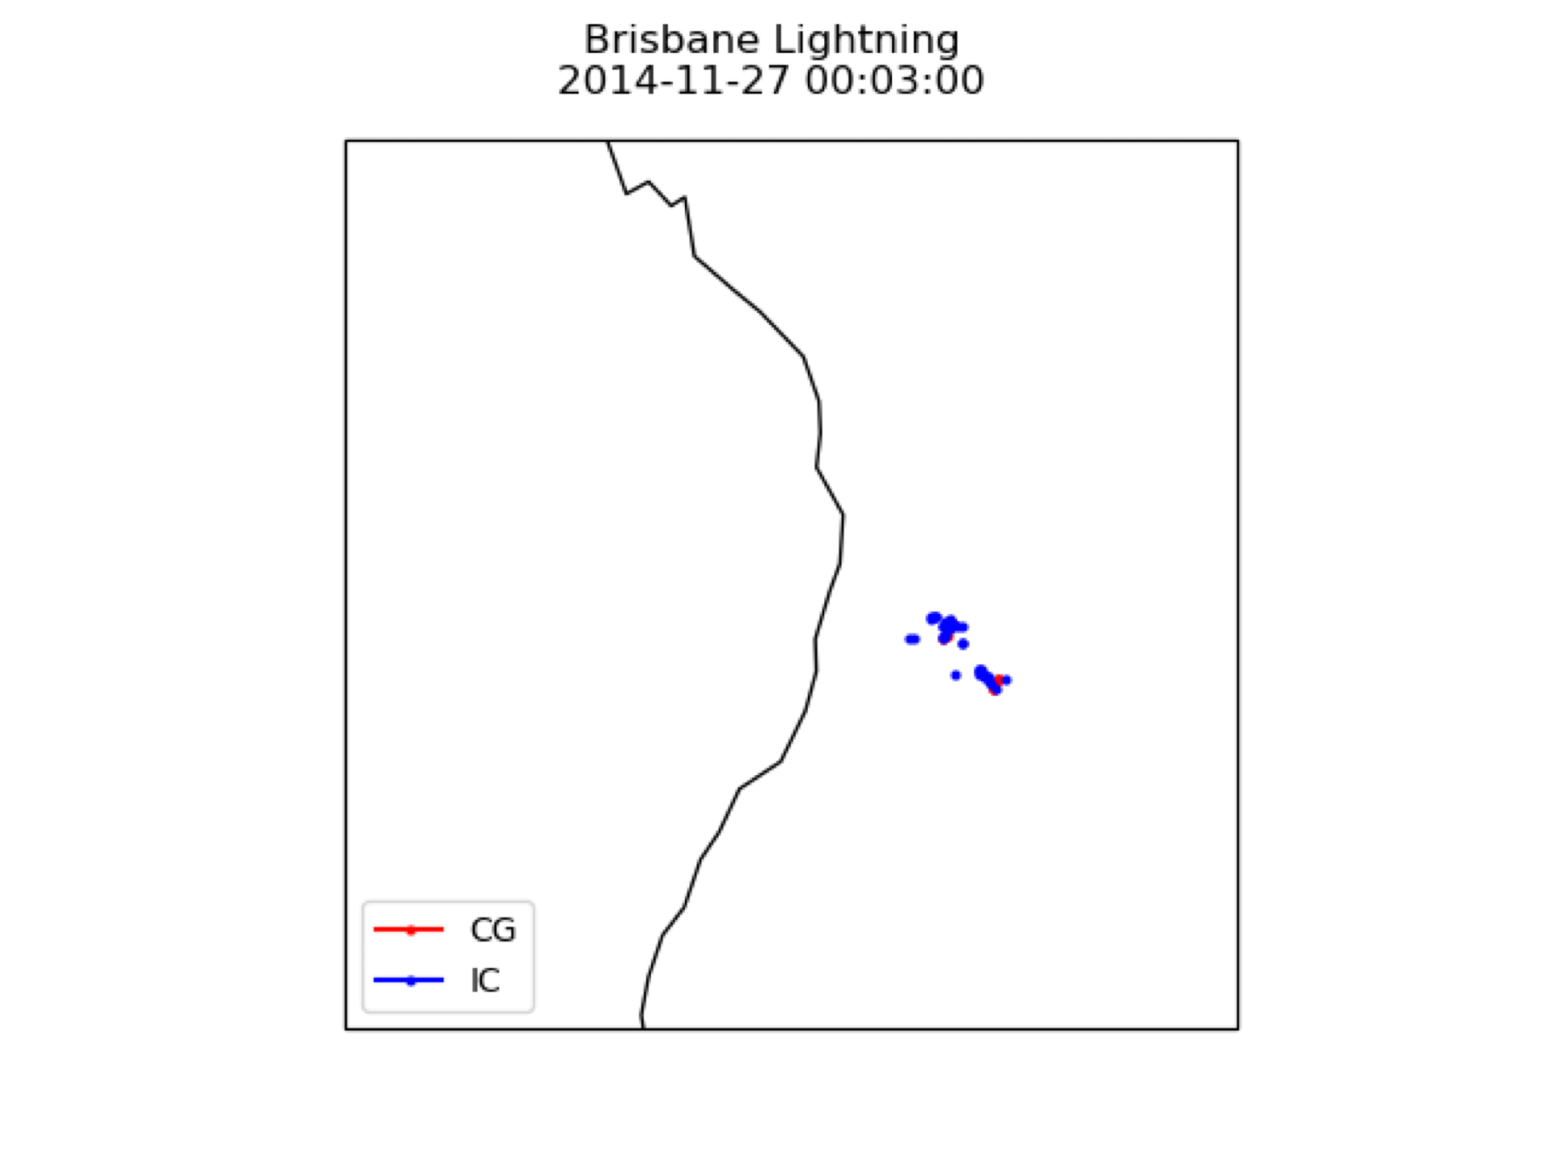
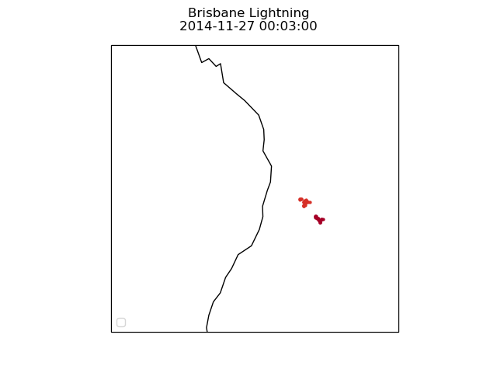
Lightning Cluster — DBSCAN
Method: DBSCAN — Density-based Clustering Algorithm (Unsupervised)
Only the minimum amount of instance & maximum value of distance is required for processing
Different Cluster
Distance <= 0.24
Instance >= 20
Outlier

Slide 10
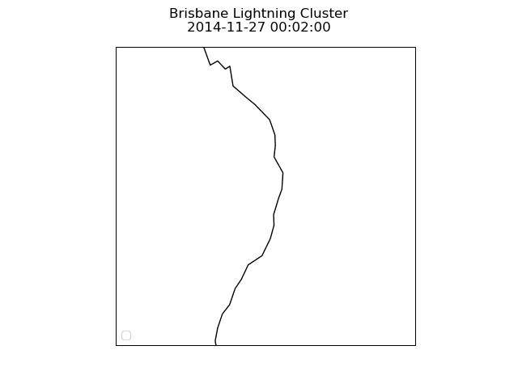
Lightning Cluster — Tracking
e.g. Cluster 7 of Brisbane 2014-11-27 Tracking
Each Frame = 2 minutes Interval
Logic — Closest Cluster at the Next Moment

Slide 11
Logic Flowchart
Ground Based
Lightning Data
Lightning Collection
of Case Study
Lightning Cluster in
Specific Time Range
Obtain Lightning Jump
Period in each Cluster
Detect Lightning Jump
with 2-Sigma Algorithm
Track Lightning Cluster
Movement Track
LJ Detection
Use LJ Centroid to
Detect the Nearby Radar
Record the SHI Information
from the Detected Radar
Parallel Processing
(More Case-Study)

Slide 12
Lightning Jump — 2-Sigma (Schulz et al., 2016)
 | Time | 1 | 2 | 3 | 4 | 5 | 6 | 7
Total Lightning Flash |  | A | B | C | D | E | F | G
Example |  | 25 | 35 | 45 | 55 | 75 | 90 | 110
90 > Threshold (20)
110 > Threshold (20)
Difference | 10 | 10 | 10 | 25 | 15 | 20
Standard Deviation = 5.831
Valid LJ
Sigma = 20 / 5.831 = 3.43 > 2 = Threshold

Slide 13
Lightning Jump — Same Jump (Duration)
Time | LJ Status (Case 1) | LJ Status (Case 1) Altered | LJ Status (Case 2) | LJ Status (Case 2) Altered | LJ Status (Case 3) | LJ Status (Case 3) Altered
10:00 | TRUE | LJ_0 | TRUE | LJ_0 | FALSE | FALSE
10:02 | FALSE | SAME_JUMP | FALSE | SAME_JUMP | FALSE | FALSE
10:04 | FALSE | SAME_JUMP | FALSE | SAME_JUMP | FALSE | FALSE
10:06 | FALSE | SAME_JUMP | TRUE | SAME_JUMP | FALSE | FALSE
10:08 | TRUE | LJ_1 | FALSE | SAME_JUMP | TRUE | LJ_0
10:10 | FALSE | SAME_JUMP | FALSE | SAME_JUMP | FALSE | SAME_JUMP
10:12 | FALSE | SAME_JUMP | FALSE | SAME_JUMP | FALSE | SAME_JUMP

Slide 14
Logic Flowchart
Ground Based
Lightning Data
Lightning Collection
of Case Study
Lightning Cluster in
Specific Time Range
Obtain Lightning Jump
Period in each Cluster
Detect Lightning Jump
with 2-Sigma Algorithm
Track Lightning Cluster
Movement Track
Use LJ Centroid to
Detect the Nearby Radar
Record the SHI Information
from the Detected Radar
Parallel Processing
(More Case-Study)
Validation

Slide 15
Validation — SHI (Severe Hail Index) Collocation
Time | LJ Status (Case 1) Altered | Coordinate
10:00 | LJ_0 | (X0, Y0)
10:02 | SAME_JUMP
10:04 | SAME_JUMP
10:06 | SAME_JUMP
10:08 | LJ_1 | (X1, Y1)
10:10 | SAME_JUMP
10:12 | SAME_JUMP
Scan
SHI Information (within 50 minutes)
Max SHI
Severe Hail Coordinate
LJ Detection Valid Size
LJ Detection Invalid Size
90 Percentile of SHI above Threshold
Range = 0.5 Degree
Scan

Slide 16
Logic Flowchart
Ground Based
Lightning Data
Lightning Collection
of Case Study
Lightning Cluster in
Specific Time Range
Obtain Lightning Jump
Period in each Cluster
Detect Lightning Jump
with 2-Sigma Algorithm
Track Lightning Cluster
Movement Track
Use LJ Centroid to
Detect the Nearby Radar
Record the SHI Information
from the Detected Radar
Parallel Processing
(More Case-Study)
More Data

Slide 17
More Case-Studies
mpi4py — Parallel Processing (High Efficient)
Create Yearly Case-Study Data in Parallel (e.g. Brisbane Data from 2021-01-01 ~ 2021-12-31)
Create X Case-Studies Data in One Day in Parallel (e.g. Melbourne on 2021-10-01 & Brisbane on 2021-10-02 etc.)

Slide 18
Tunable Variables
Cluster Size (DBSCAN Minimum Lightning Amount within Cluster) — P9
Within Cluster Distance (DBSCAN Maximum Distance between Lightnings) — P9
Between Cluster Distance (Cluster Tracking / Attention Switching) — P9
Sigma Value (2-Sigma Method Sigma Threshold) — P13
Lightning Amount (2-Sigma Method Lightning Amount Threshold) — P13
LJ Detection Range (Maximum Distance between LJ Centroid and the Radar) — P15
Valid Severe Hail Value (Threshold of Severe Hail based on SHI Value) — P15

Slide 19
Current Focus
Cluster Size (DBSCAN Minimum Lightning Amount within Cluster)
Within Cluster Distance (DBSCAN Maximum Distance between Lightnings)
Between Cluster Distance (Cluster Tracking / Attention Switching)
Number of Cluster (Outliers) & Lightning Jump Identification

Slide 20
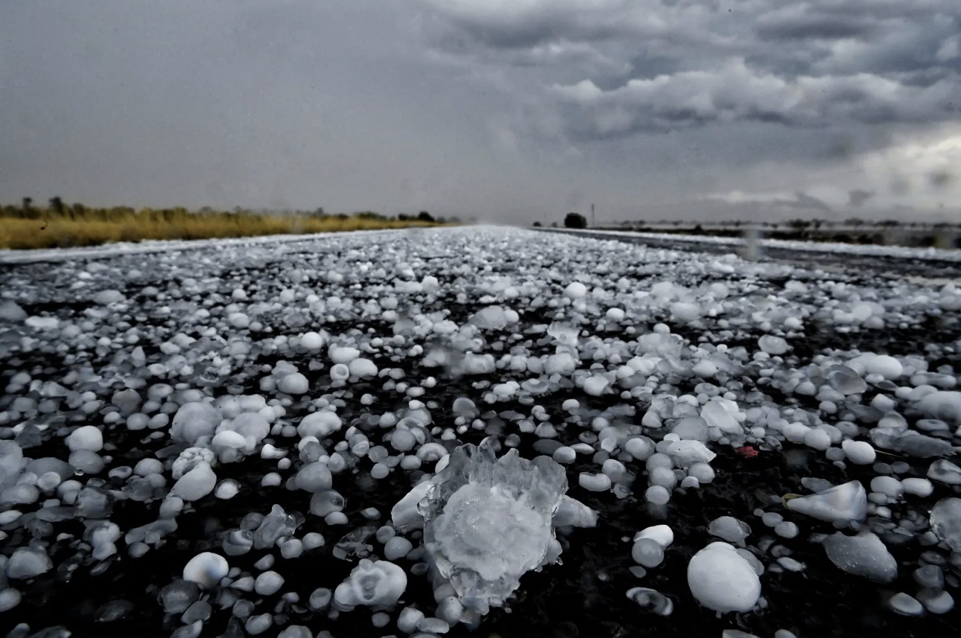
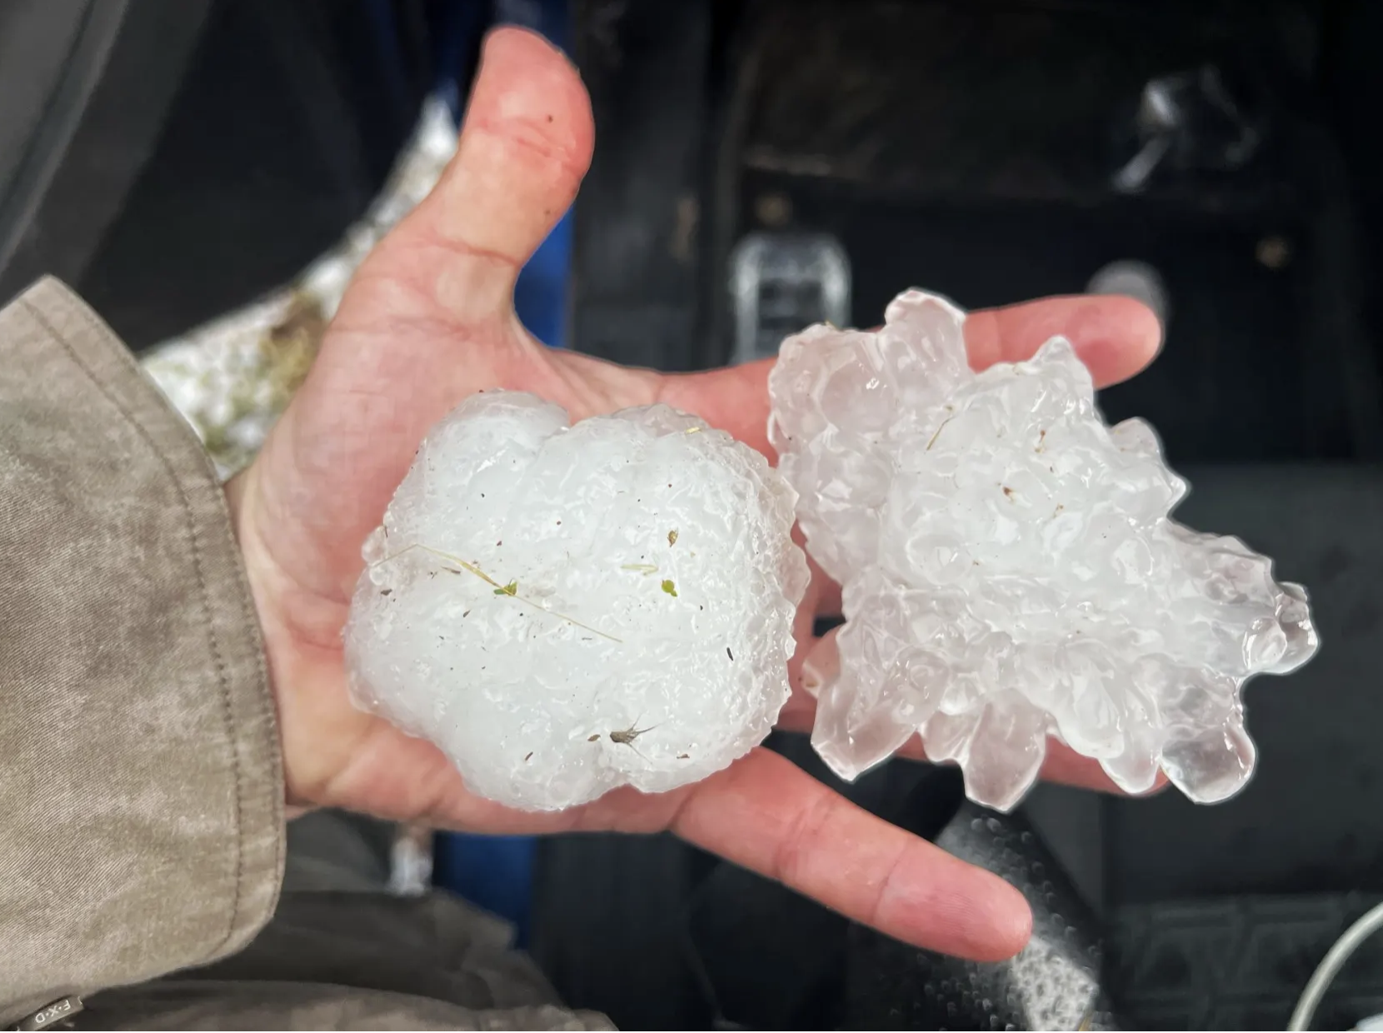
Case Study
Bourke NSW – 29/09/2021
Hail north of Bourke 29/09/2021 – Nick Moir
Source:https://www.smh.com.au/national/giant-hail-flooding-monster-waves-and-tornadoes-in-2021-by-herald-photographer-nick-moir-20211214-h20lh2.html
Giant Hail north of Bourke 29/09/2021 – Nick Moir
Source:https://www.smh.com.au/national/giant-hail-flooding-monster-waves-and-tornadoes-in-2021-by-herald-photographer-nick-moir-20211214-h20lh2.html

Slide 21

Bourke NSW 29/09/2021
Source: https://worldweather.wmo.int/185/c00369m.htm

Slide 22
Step 1:
Detection
Does the lightning jump algorithm successfully detect lightning jumps?

Slide 23
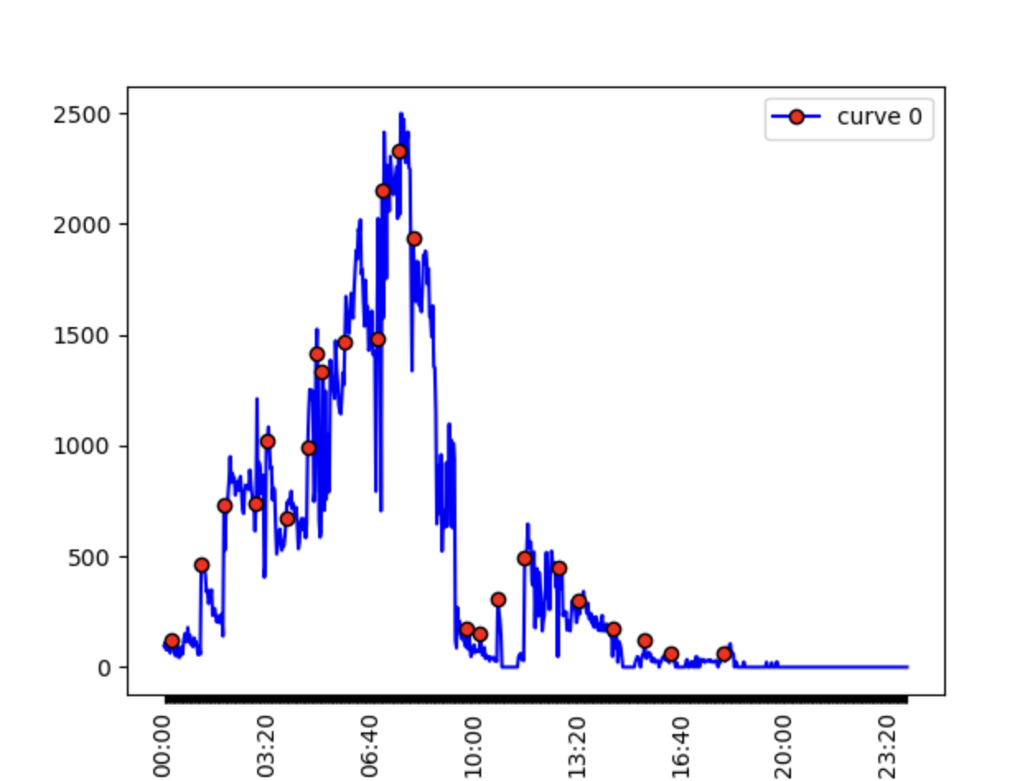
Bourke NSW 29/09/2021
Lightning time series Bourke 29/09/2021
Detected 24 individual lightning jumps in cluster 0
56 clusters were detected for Bourke on this day
Flashes/min
Time UTC

Slide 24
Step 2:
Validation
Can we validate that the lightning jump occurred prior to a severe weather event?

Slide 25
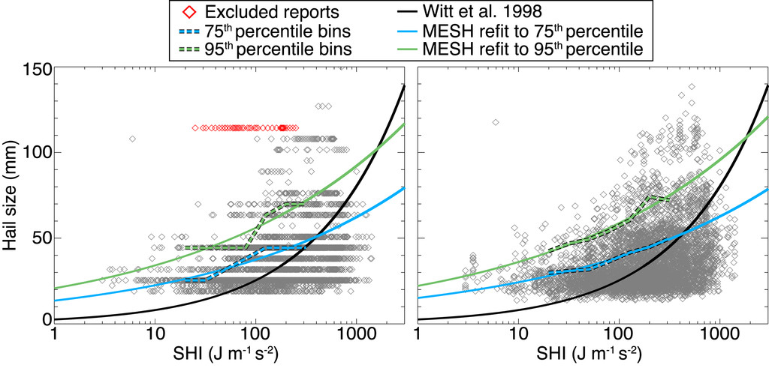
Severe Hail Index
What does it really tell us?
Severe Hail Index (SHI) has a relationship with Maximum Estimated Hail Size (MESH).
With a threshold of MESH=30mm for severe weather, an SHI threshold of 26.6 was calculated using the relationship determined by Murillo & Homeyer (2019).

Slide 26
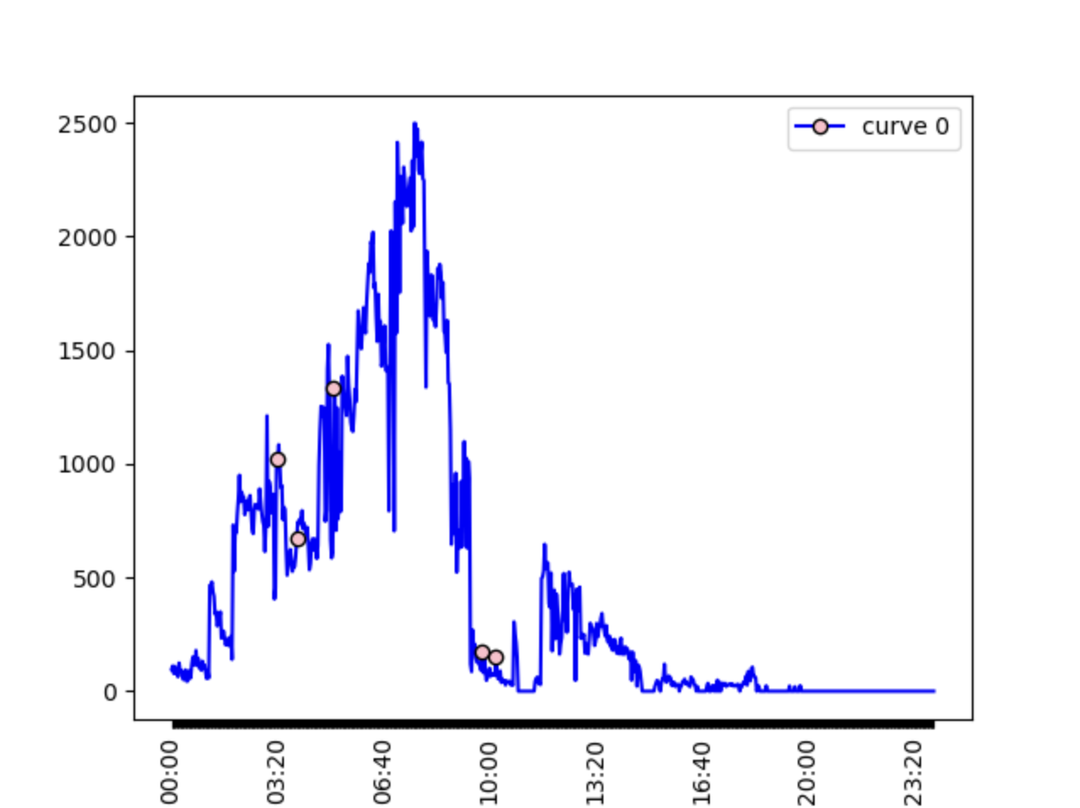
Bourke NSW 29/09/2021
Same graph - with only the lightning jumps matched with severe hail.
5 lightning jumps were matched.
The first 3 jumps will be analysed further
Lightning time series Bourke 29/09/2021
Reminder:
Matched= lightning cluster centroid is within 50 minutes of a max SHI >26.6
and within .5degree
Flashes/min
Time UTC

Slide 27
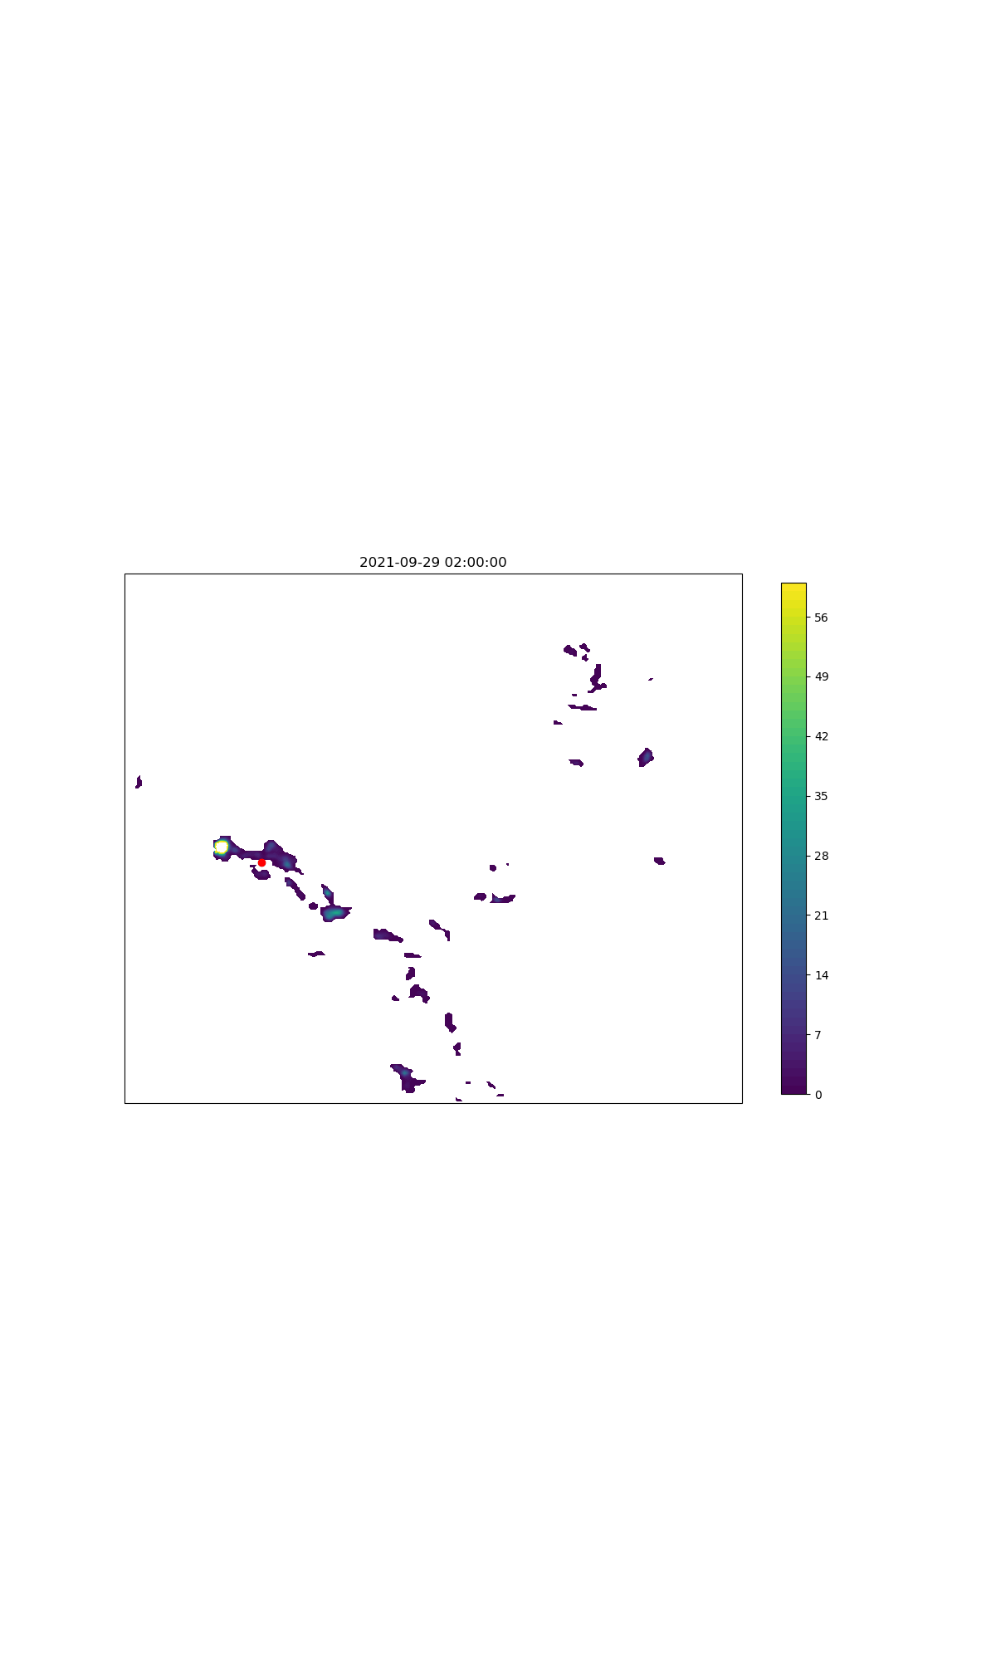
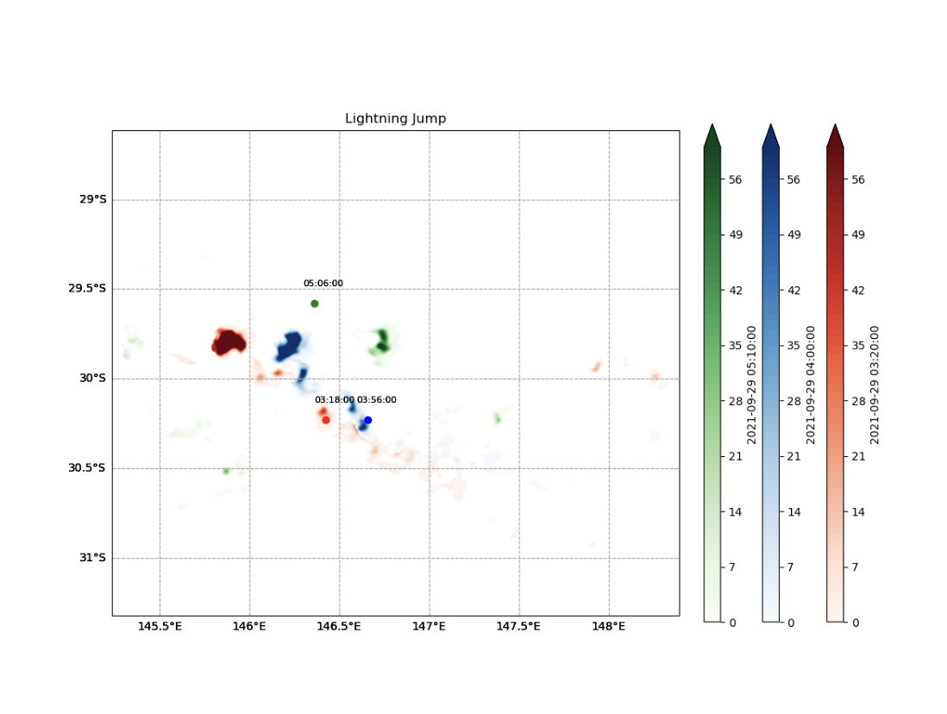
Bourke NSW 29/09/2021
Severe Hail Index: Timelapse
Lightning Jump 3
Lighting Jump 2
Severe Hail Index
Severe Hail Index
Lightning Jump 1
Bourke NSW
Lightning Jump 1: 03:18:00, SHI: 03:20:00
Lightning Jump 2: 03:56:00, SHI: 04:00:00
Lightning Jump 3: 05:06:00, SHI: 05:10:00
Note: the LJ ‘dots’ are the centroid of the cluster
Severe Hail > 26.6 == MESH=30mm

Slide 28
Step 3:
Analysis and Statistical Validation

Slide 29
Quality controlling and tidying the data
Lightning Clusters easily split and rejoin leading to the same cluster being recorded multiple times.
What are consequences?
Bias towards certain events
Extra noise within datasets
Unclear plots
What overlaps do we check for?
Same cluster -> different LJ -> same SW
Different cluster -> same LJ -> same SW
What overlaps do we not check for?
Different cluster -> same LJ -> different SW
Lightning Clusters easily split and rejoin, they are very variable.
Cluster 1
Cluster 2
Cluster 3
Cluster 4
Cluster 5

Slide 30
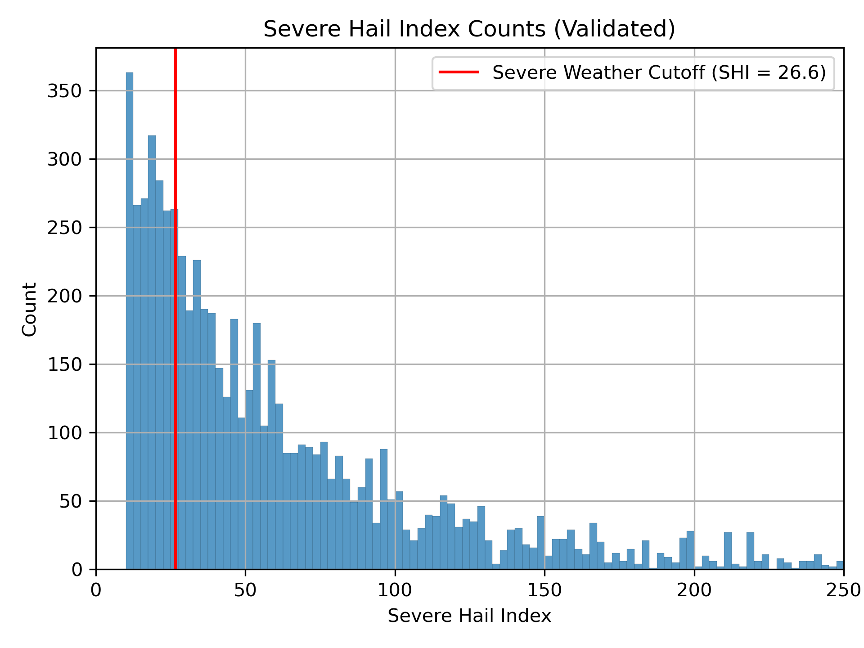
Distribution of matched SHI values
Included in this plot are all SHI values within the matched 50 minute range of a lightning jump.
SHI 26.6 = 30mm MESH

Slide 31
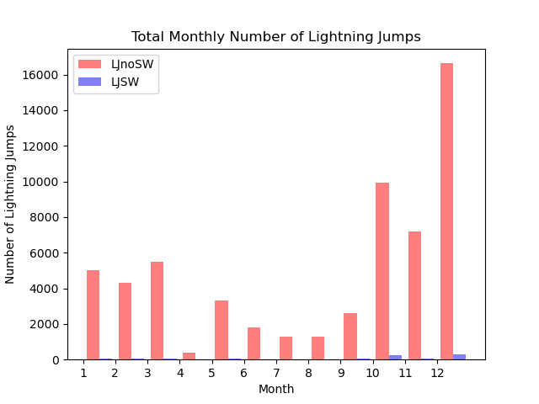
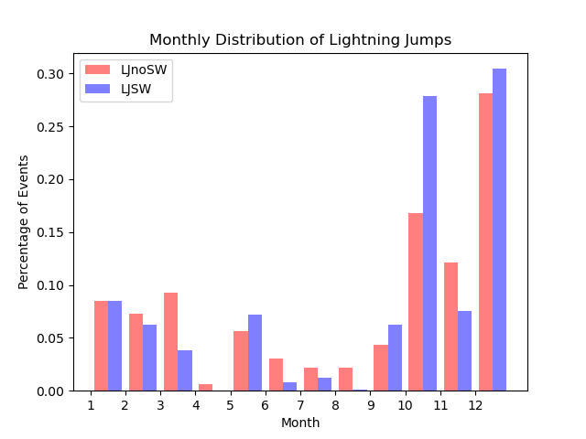
Monthly Lightning Jump Frequencies
Many lightning jumps do not match to Severe Hail
Normalised to LJnoSW and LJSW
SW= Severe Weather
LJ = Lightning Jump
2021 Brisbane Data

Slide 32
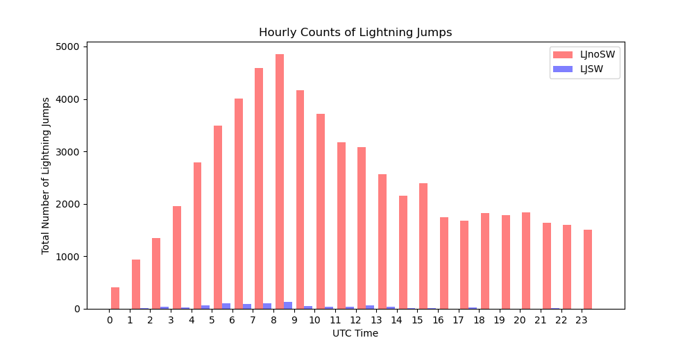
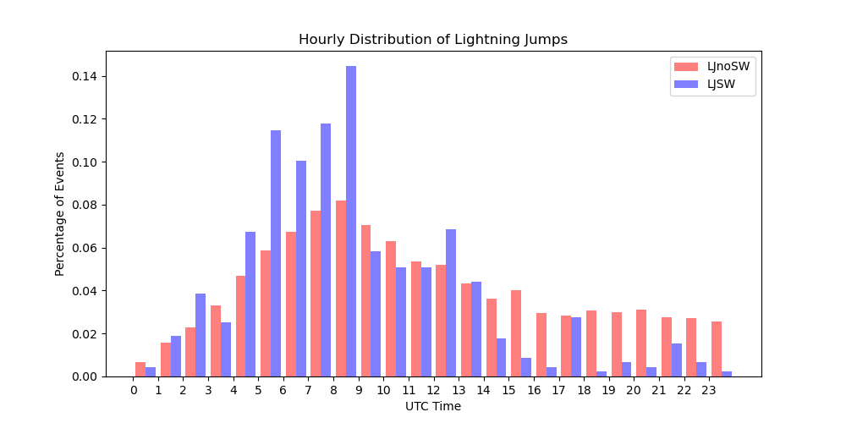
Hourly Lightning Jump Frequencies
Normalised to LJnoSW and LJSW
SW= Severe Weather
LJ = Lightning Jump
7 UTC approx 5pm AEST (AEST is 10 hours ahead)
2021 Brisbane Data

Slide 33
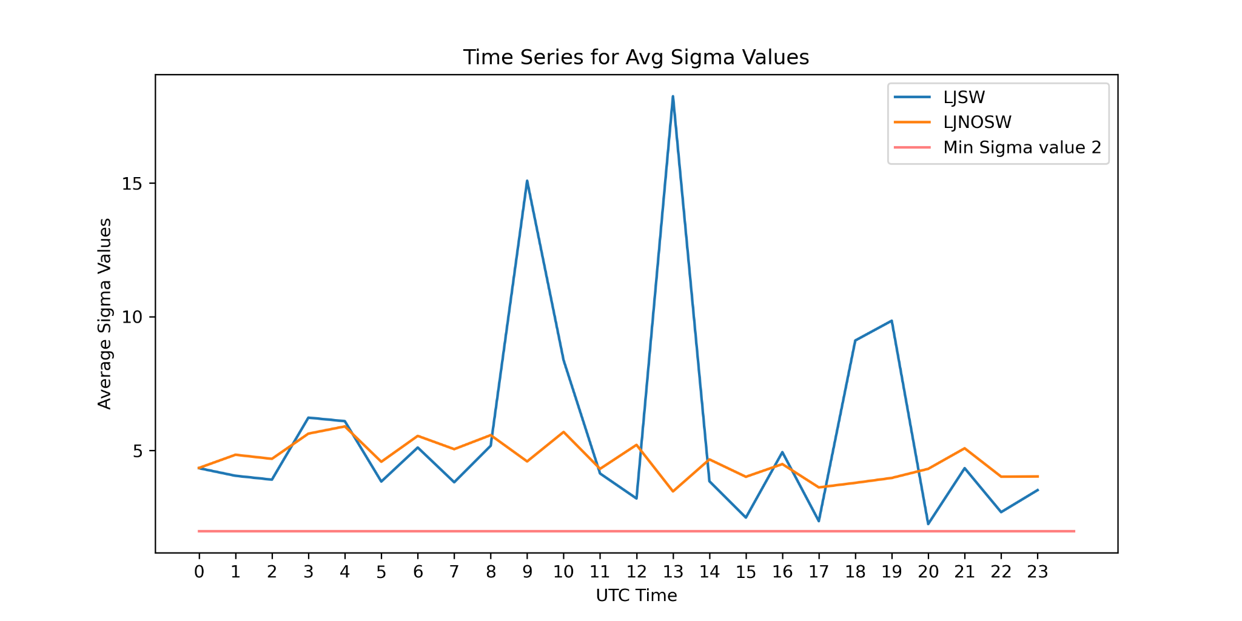
Difference between Sigma values
Lightning Jumps with Severe Weather:
Larger Sigma values
More variable
Lightning Jumps without Severe Weather:
have smaller Sigma values
More consistent Sigma values
2021 Brisbane Data

Slide 34
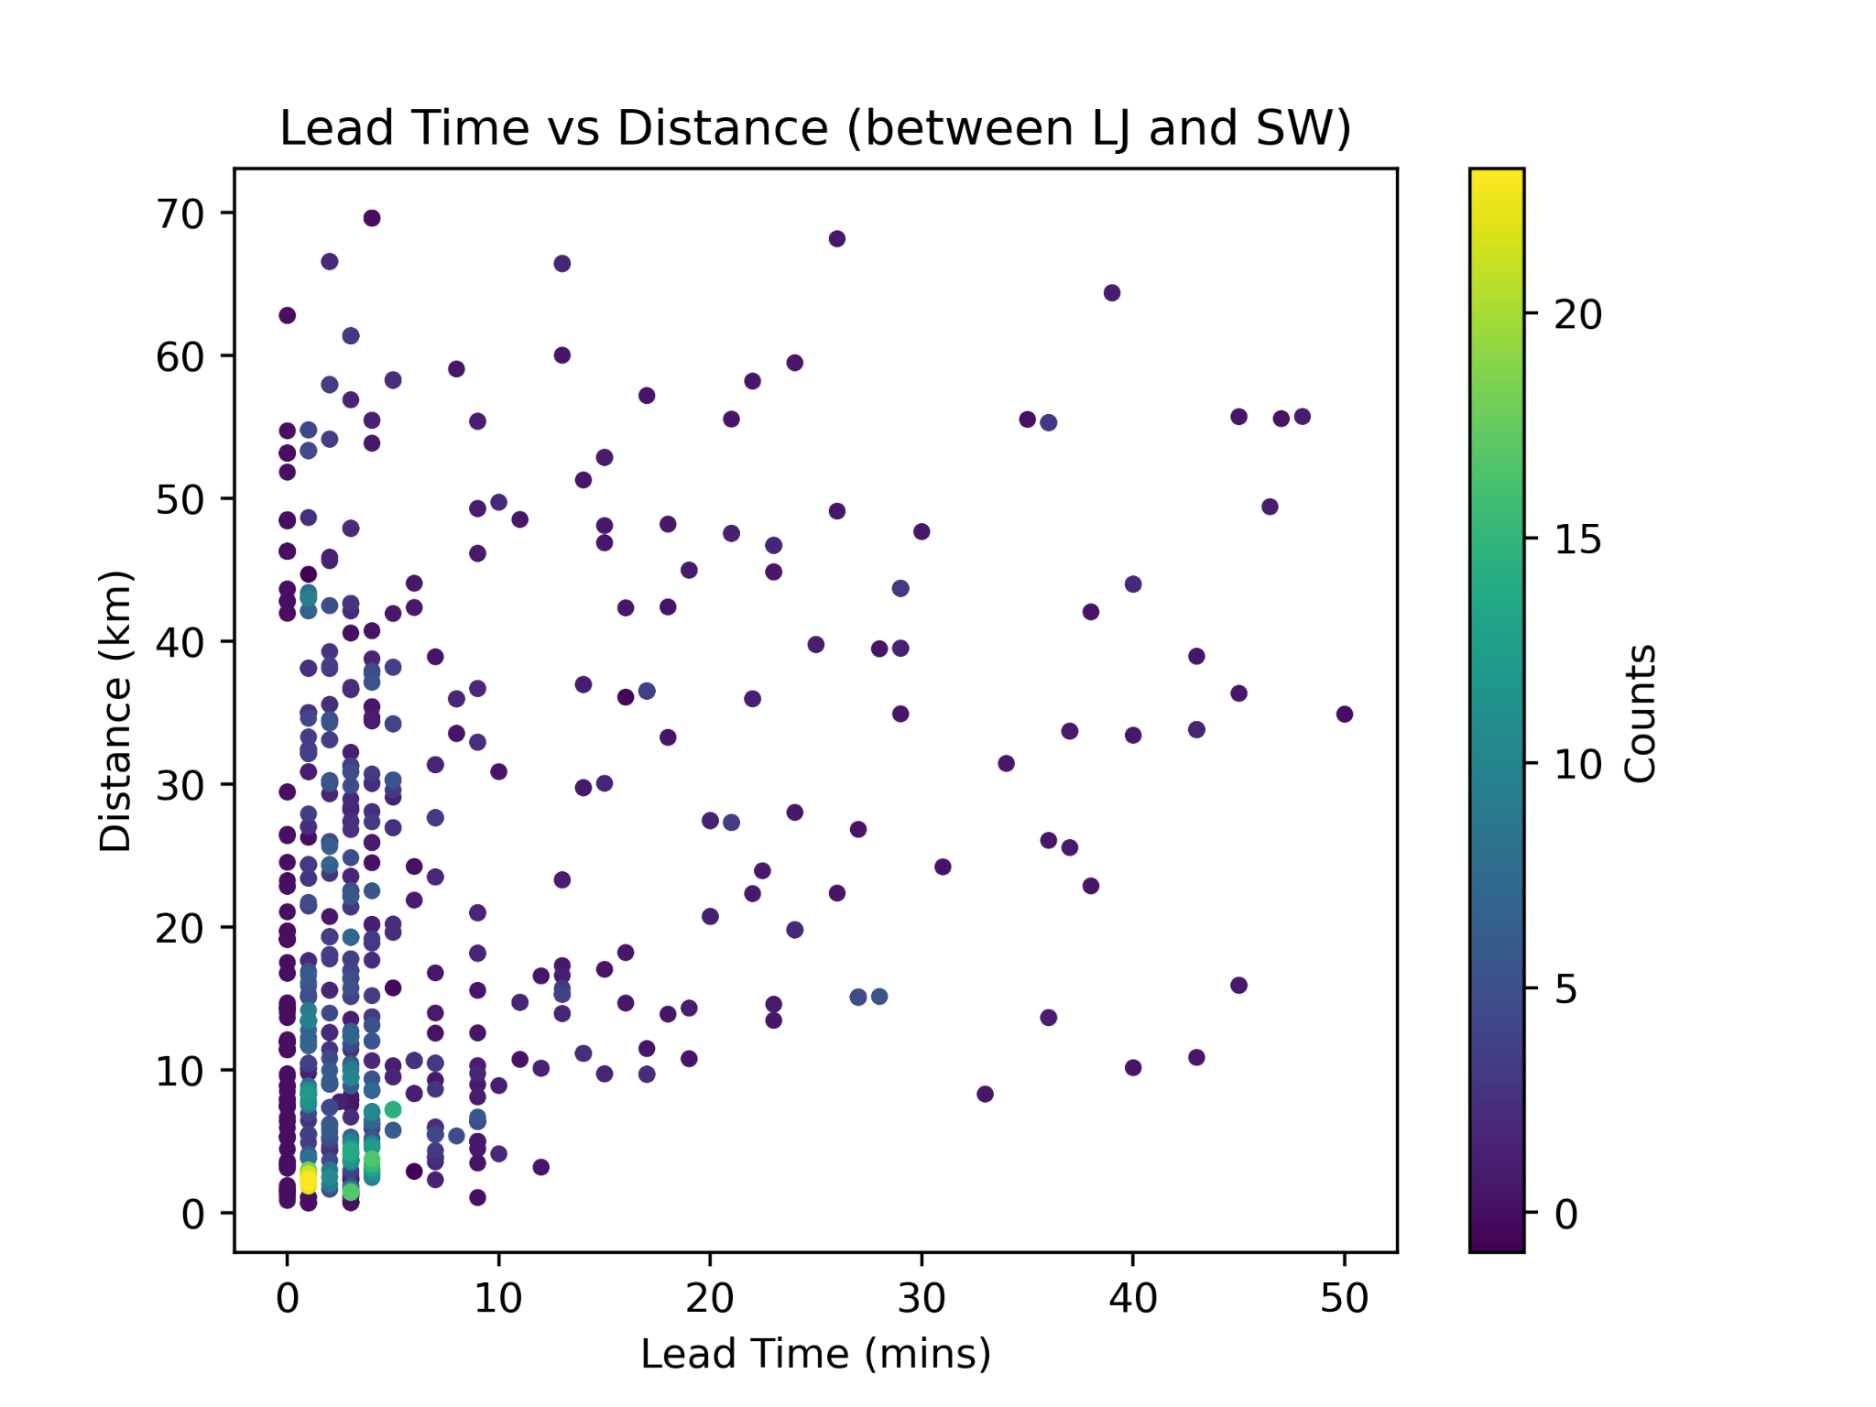
Lead Time and Distance
Distance is calculated from the centroid of the Lightning Jump Cluster to the centroid of the Severe Hail Cluster
Lightning Jump Cluster has approx 25-30 km radius
Radars record data in 5-10 minute intervals
2021 Brisbane Data

Slide 35
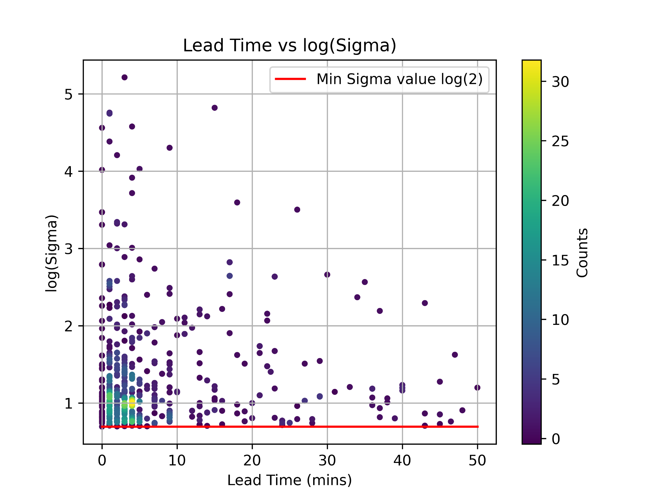
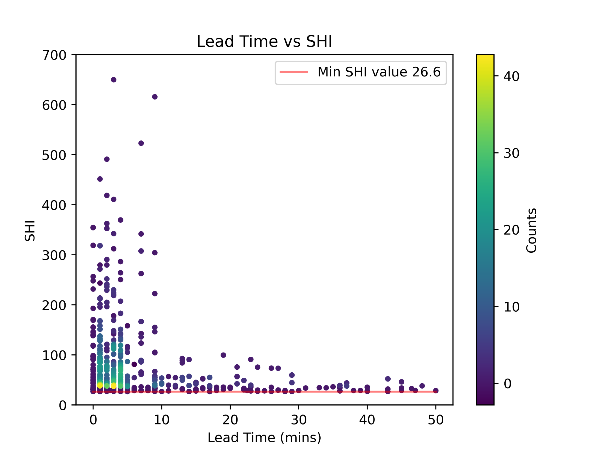
Lead Times, Sigma values, SHI values
No clear correlations

Slide 36
Summary
We have developed a lightning jump algorithm
Still many variables to tune → improvement to our algorithm
Investigated relevant case studies
Validated a year's worth of data over the Brisbane region
Created a database of collated Lightning Jump and Severe Hail data
Analysis
Lightning/Severe hail more prevalent October to December (Brisbane)
Many lightning jumps are not associated with Severe Hail
Severe Hail events have larger sigma values
Typical lead times approx 5-10 minutes

Slide 37
Future Direction
Database of collated Lightning Jump and Severe Hail data
Investigation Range (Case-Study -> Australia)
Tunable variables
There are cluster characteristics that can be varied
e.g size of the cluster and distance between the cluster.
The Sigma/SHI can be varied
We could introduce more meteorological information to provide more data on storm severity
e.g cloud characteristics from satellite and radar (partial coverage)
Validate against other severe weather (wind, rain)
Use new dataset to design a ML technique which can identify severe storms
See how satellite lightning data could complement this technique (using MTG-LI or GLM)

Slide 38
Thank you

Slide 39
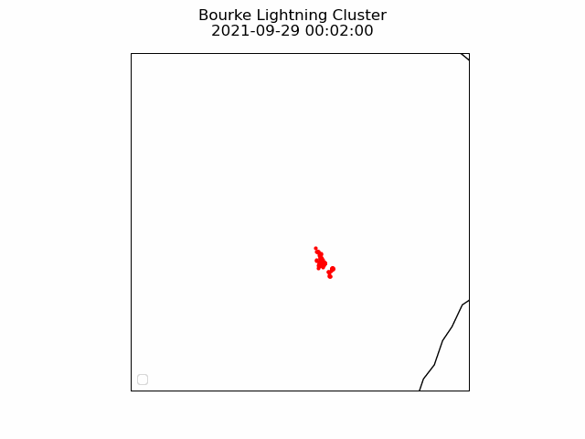
Additional Information

Slide 40
Logic: Removing inter cluster similarity
Checking for different lightning jumps matched to the same severe hail event. Example:
Step 1: Check for overlapping time blocks
Tunable variable: number of overlapping blocks
Step 2: Check MAX SHI
Step 3: Check coordinates where MAX SHI values were recorded
Step 4: Keep row with earlier Lightning Jump occurrence time
Time | 22:00 | 22:10 | 22:20 | 22:30 | 22:40 | 22:50 | 23:00 | 23:10
Lightning Jump 1 MAX SHI | Lightning Jump 1 | 52.5 | 68.3 | 96.2 | 109.8 | 225.4
Lightning Jump 2 MAX SHI |  |  | Lightning Jump 2 | 96.2 | 109.8 | 225.4 | 30.5 | 40.8

Slide 41
Logic: Removing intra cluster similarity
Checking for same Lightning Jumps between different clusters.
Step 1: Checking time of Lightning Jumps
Step 2: Checking location of Lightning Jumps
Step 3: Remove identical duplicate row

Slide 42
Reference
Schultz, E. V., Schultz, C. J., Carey, L. D., Cecil, D. J., & Bateman, M. (2016).
Automated storm tracking and the lightning jump algorithm using GOES-R Geostationary
Lightning Mapper (GLM) proxy data. Journal of operational meteorology, 4(7), 92.

